Slide 1
Basic Electronics Engineering FE 2024 Course
Presented by
Mr. Aniruddha Nirmal
Assistant Professor
Department of First Year Engineering
DPCOE Pune

Slide 2
Unit III : Logic Gates and Digital Circuits
Syllabus
Number System:
Binary, Octal, Decimal, Hexadecimal, BCD, their conversion and arithmetic
De-Morgan’s theorems.
Logic Gates: Classification
Basic gates: AND, OR, NOT
Universal gate: NAND, NOR
Other gates: XOR, XNOR
Combinational Design
Half adder
Full adder
Flip Flop’s:
SR Latch, Flip Flops - SR, JK, T and D
Introduction to,
Microprocessor (µP) - Block diagram (Architecture) and explanation
Microcontroller (µC) - Block diagram (Architecture) and explanation

Slide 3
Number System
Radix or Base (R):
The radix or base of a number system is defined as the number of different digits (Basic elements) which can occur in each position in the number system.
Radix Point:
The generalized form of a decimal point is known as radix point. In any positional number system the radix point divides the integer and fractional part.
N_{r} = [ Integer part . Fractional part ]
↑
Radix point (Binary pt./Decimal pt./ Octal pt./Hex. pt.)
Where, N_{r} – Number in base “r” system

Slide 4
Classification of Number System
Number System
Binary (Base-2)
Hexadecimal (Base-16)
Octal (Base-8)
Decimal (Base-10)
BCD (Binary Coded Decimal)
Note: Except BCD all other number systems are Positional weighted systems

Slide 5
Description about of Number System
Number system | Base or Radix of the system | No. of digits/ elements used | Digits/Elements/ Symbols used in the system | Least element of the system | Largest element of the system
Binary (B) | 2 | 2 | 0, 1 | 0 | 1
Octal (O) | 8 | 8 | 0, 1, 2, 3, 4, 5, 6, 7 | 0 | 7
Decimal (D) | 10 | 10 | 0, 1, 2, 3, 4, 5, 6, 7, 8, 9 | 0 | 9
Hexadecimal (H) | 16 | 16 | 0, 1, 2, 3, 4, 5, 6, 7, 8, 9, A, B, C, D, E, F | 0 | F
BCD (Binary Coded Decimal) | 4-Bit binary equivalent of each digit (from 0 to 9) |  | 0000, 0001, 0010, 0011, 0100, 0101, 0110, 0111, 1000, 1001 | 0000 | 1001

Slide 6
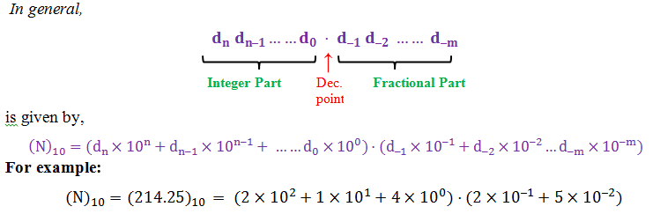
Decimal (Base-10)- Number System
The number system we are familiar with, used every day, is the decimal number system.
Referred to as the base 10 system.
The base 10 system is a positional weighted system
The base 10 number system has 10 distinct symbols or digits (0, 1, 2, 3, 4, 5, 6, 7, 8, 9).

Slide 7

Binary (Base-2)- Number System
All data in a computer is represented in binary form.
The term ‘bit’ is a contraction of the words ‘binary’ and ‘digit’
The base-2 system has exactly two symbols: 0 , 1 : (Logical)
A string of eight bits (such as 11000110) is termed a byte.
A string of four bits (such as 1100) is termed a nibble.
The base 2 system is a positional weighted system.

Slide 8

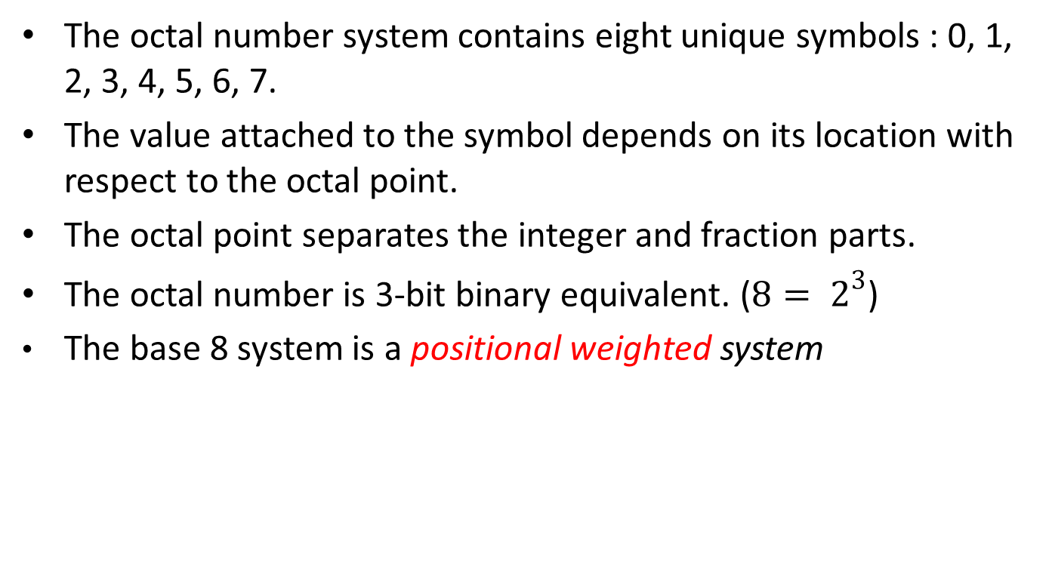
Octal (Base-8)- Number System
The octal number system contains eight unique symbols : 0, 1, 2, 3, 4, 5, 6, 7.
The value attached to the symbol depends on its location with respect to the octal point.
The octal point separates the integer and fraction parts.
The octal number is 3-bit binary equivalent. (${8= 2}^{3}$)
The base 8 system is a positional weighted system

Slide 9

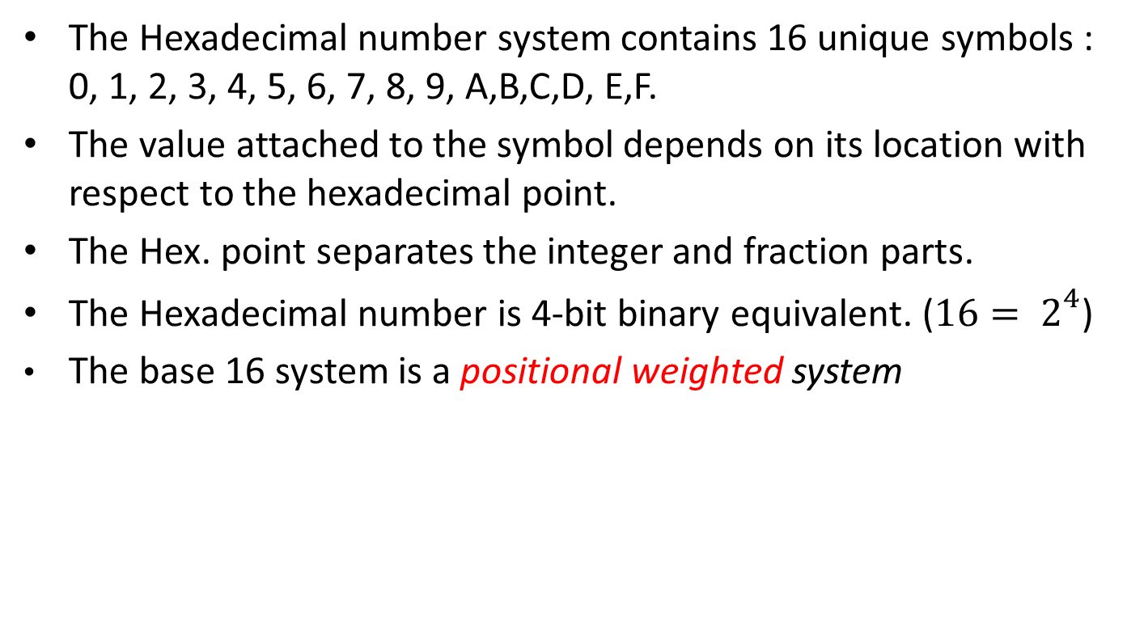
Hexadecimal (Base-16)- Number System
The Hexadecimal number system contains 16 unique symbols : 0, 1, 2, 3, 4, 5, 6, 7, 8, 9, A,B,C,D, E,F.
The value attached to the symbol depends on its location with respect to the hexadecimal point.
The Hex. point separates the integer and fraction parts.
The Hexadecimal number is 4-bit binary equivalent. (${16= 2}^{4}$)
The base 16 system is a positional weighted system

Slide 10
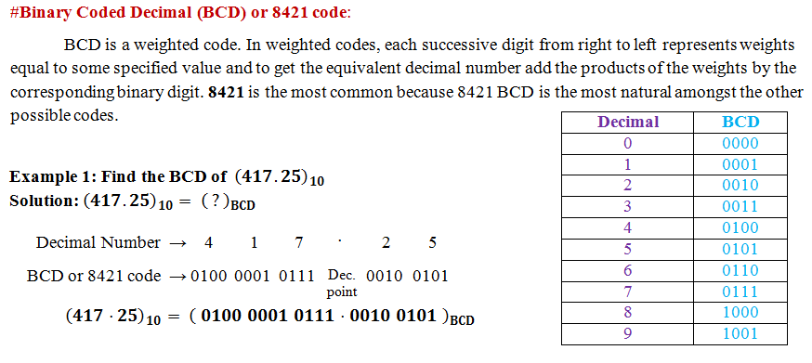
BCD (Binary Coded Decimal)- Number System

Slide 11
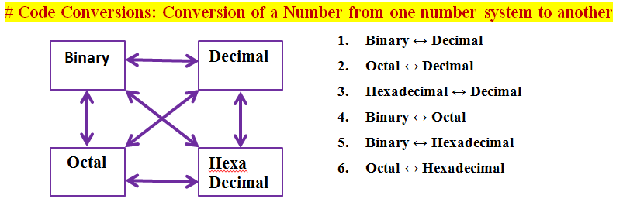
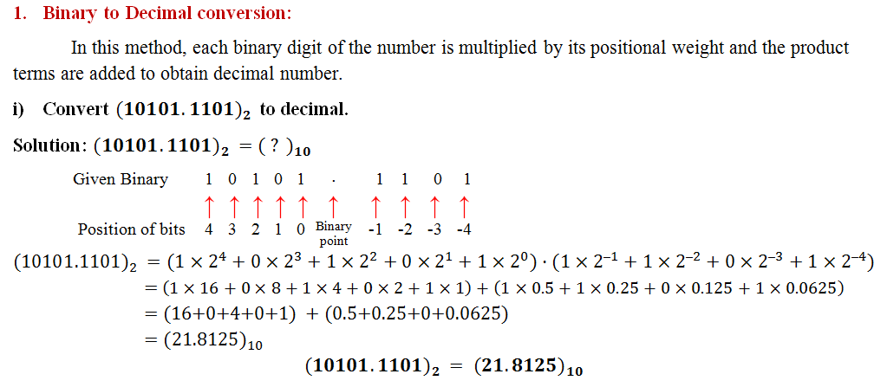
Code Conversions

Slide 12
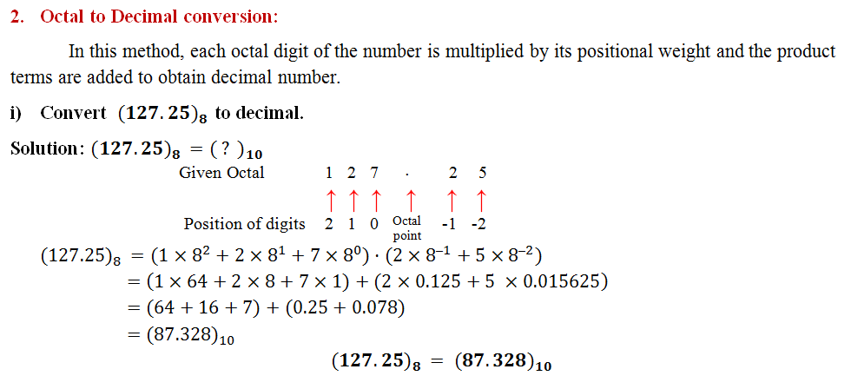
Code Conversions - Octal to Decimal

Slide 13
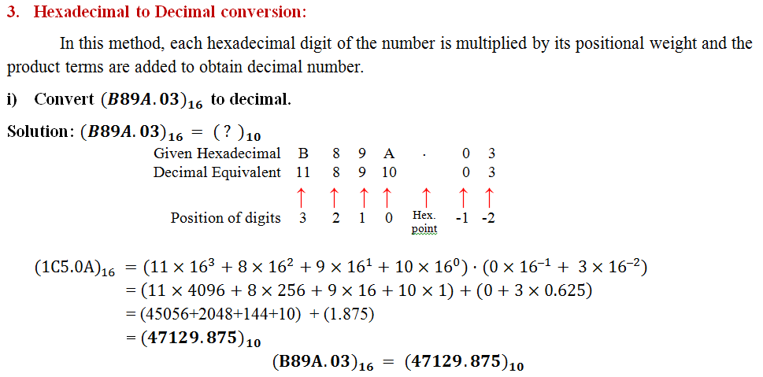
Code Conversions - Hexadecimal to Decimal

Slide 14
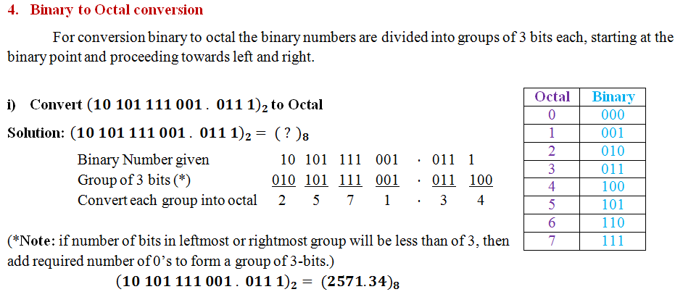
Code Conversions - Binary to Octal

Slide 15
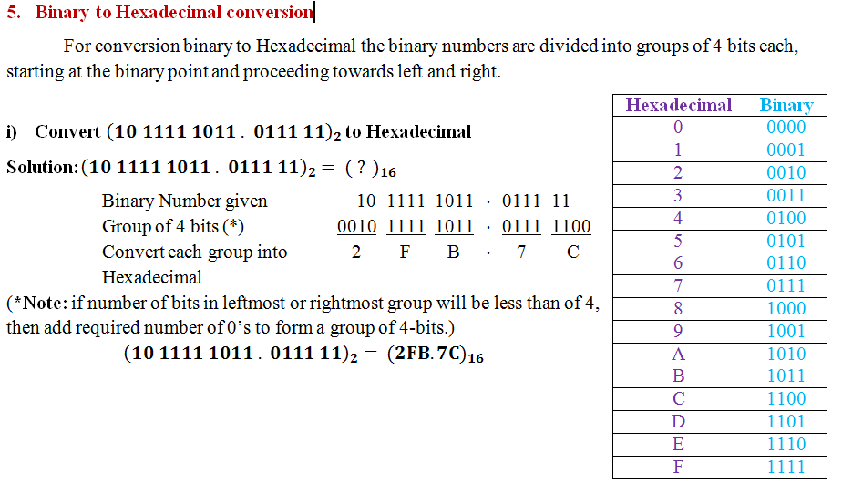
Code Conversions - Binary to Hexadecimal

Slide 16
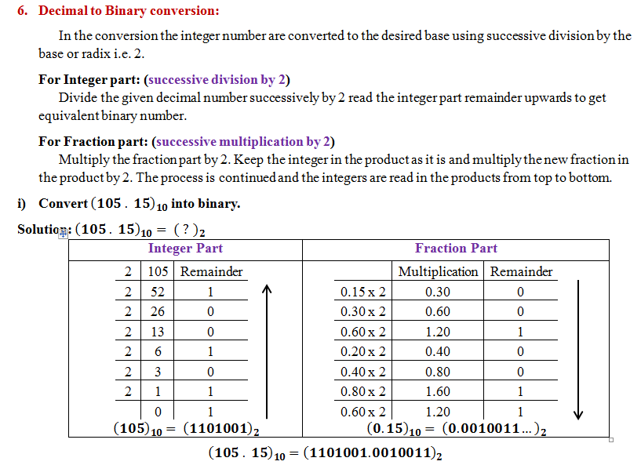
Code Conversions - Decimal to Binary

Slide 17
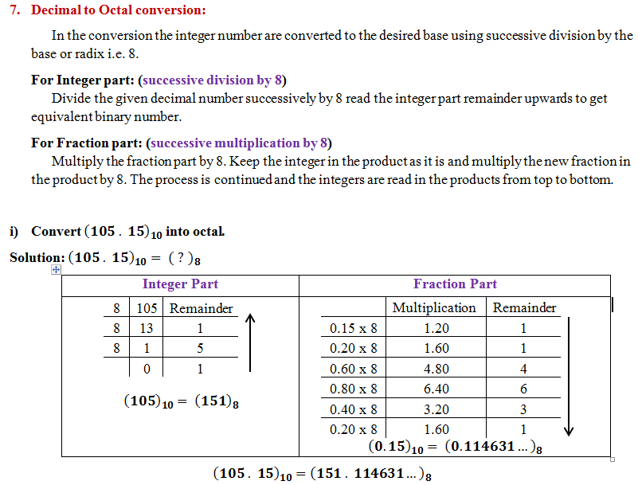
Code Conversions - Decimal to Octal

Slide 18
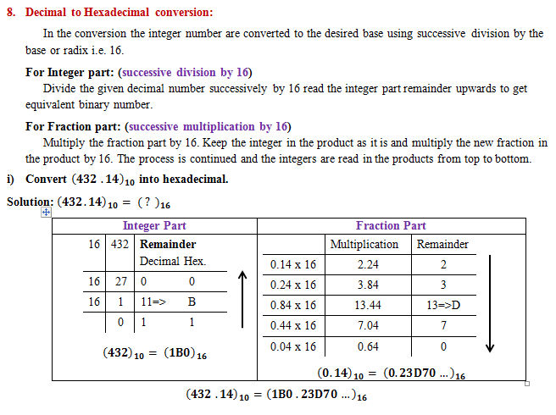
Code Conversions - Decimal to Hexadecimal

Slide 19
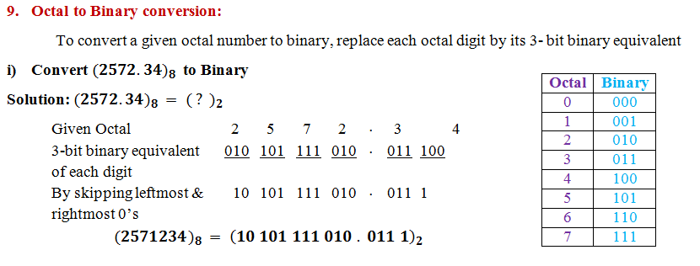
Code Conversions - Octal to Binary

Slide 20
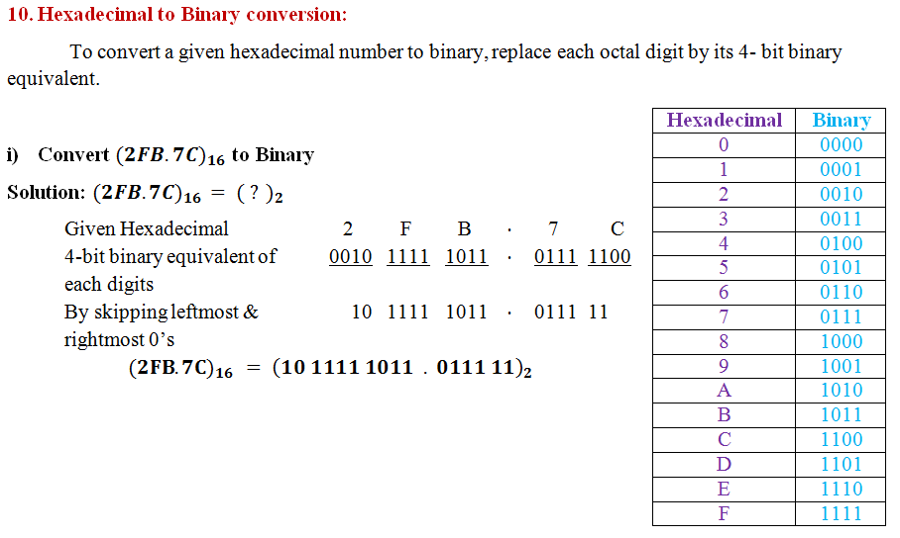
Code Conversions - Hexadecimal to Binary

Slide 21
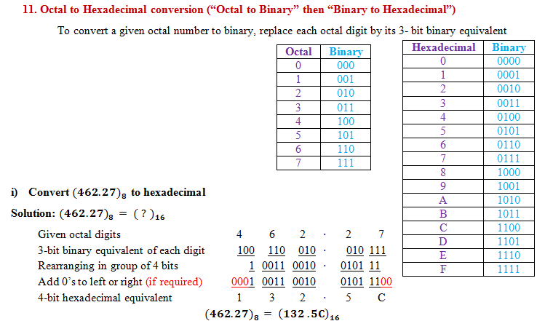
Code Conversions - Octal to Hexadecimal

Slide 22
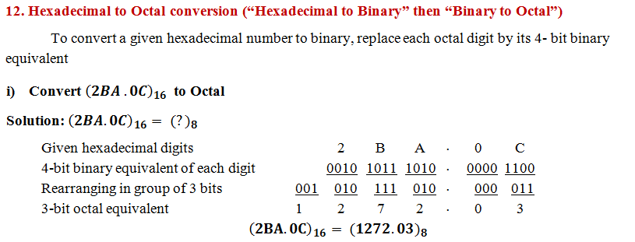
Code Conversions - Hexadecimal to Octal

Slide 23
Number Representation
Decimal | Binary | BCD | Octal | Hexadecimal
0 | 0000 | 0000 | 0 | 0
1 | 0001 | 0001 | 1 | 1
2 | 0010 | 0010 | 2 | 2
3 | 0011 | 0011 | 3 | 3
4 | 0100 | 0100 | 4 | 4
5 | 0101 | 0101 | 5 | 5
6 | 0110 | 0110 | 6 | 6
7 | 0111 | 0111 | 7 | 7
8 | 1000 | 1000 | 10 | 8
9 | 1001 | 1001 | 11 | 9
10 | 1010 | 0001 0000 | 12 | A
11 | 1011 | 0001 0001 | 13 | B
12 | 1100 | 0001 0010 | 14 | C
13 | 1101 | 0001 0011 | 15 | D
14 | 1110 | 0001 0100 | 16 | E
15 | 1111 | 0001 0101 | 17 | F
16 | 10000 | 0001 0110 | 20 | 10

Slide 24
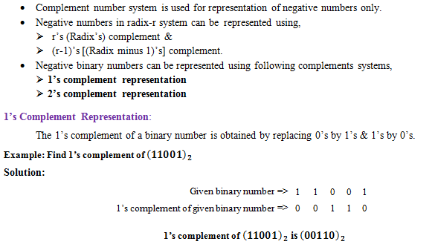
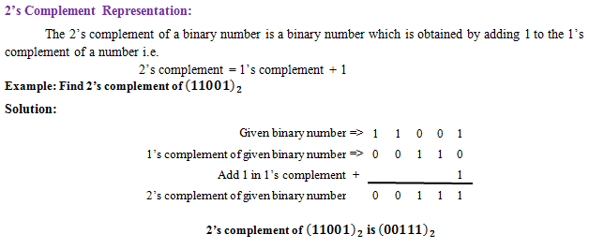
Complement Number System

Slide 25
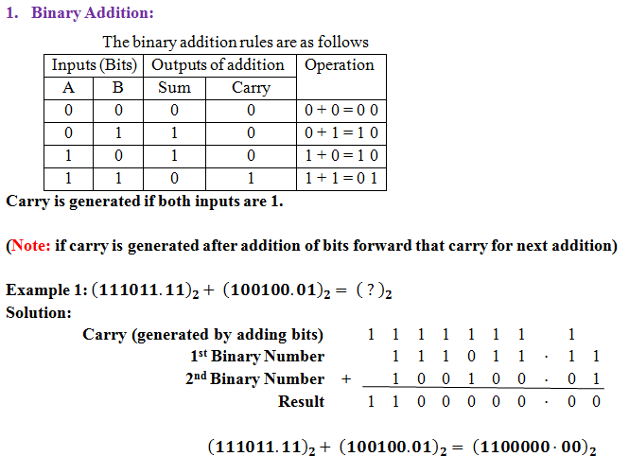
Binary Arithmetic Operations:

Slide 26
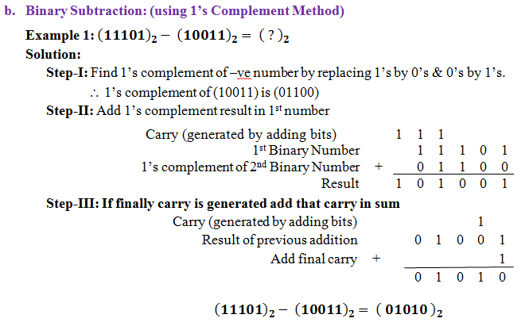
Binary Arithmetic Operations:

Slide 27
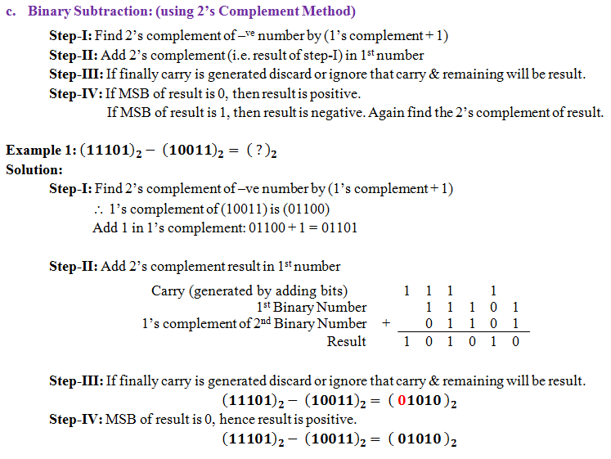
Binary Arithmetic Operations:

Slide 28
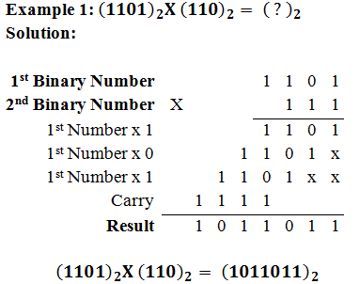
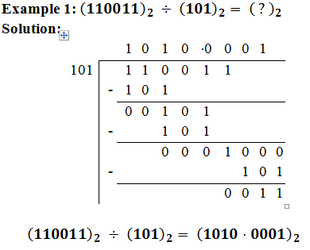
Binary Arithmetic Operations:
Binary Multiplication: | Binary Division:

Slide 29
Logic Gates & its Classification
Logic gate:
It is digital circuit which has one or more inputs and single output.
Logic gates can be classified as,
Basic gates – AND ,OR, NOT
Universal gates – NAND, NOR
Other gate (Exclusive gates) – XOR, XNOR
One input is required for NOT gate.
More than one input is required for other than NOT gate.
Logic Gates
Basic Logic Gates
Universal Logic Gates
Other Logic Gates (Exclusive gates)
AND gate
OR gate
NOT gate
NAND gate
NOR gate
XOR gate
XNOR gate

Slide 30
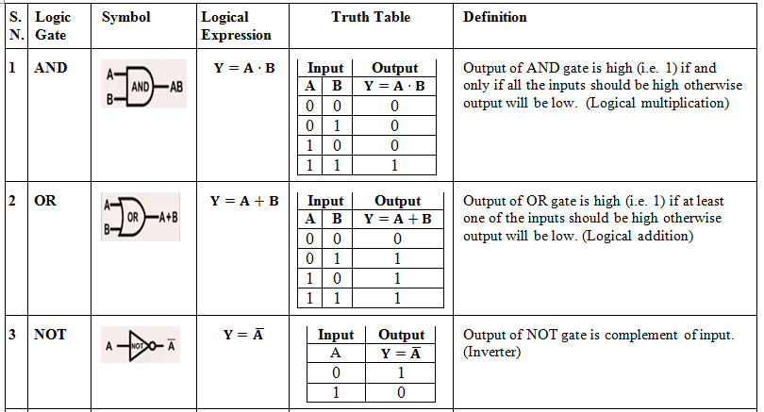
Logic Gates: Basic Logic Gates

Slide 31
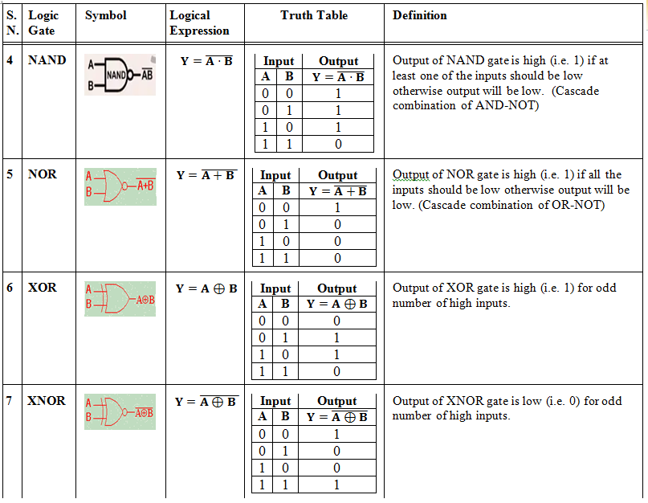
Logic Gates: Universal & Other Gates

Slide 32
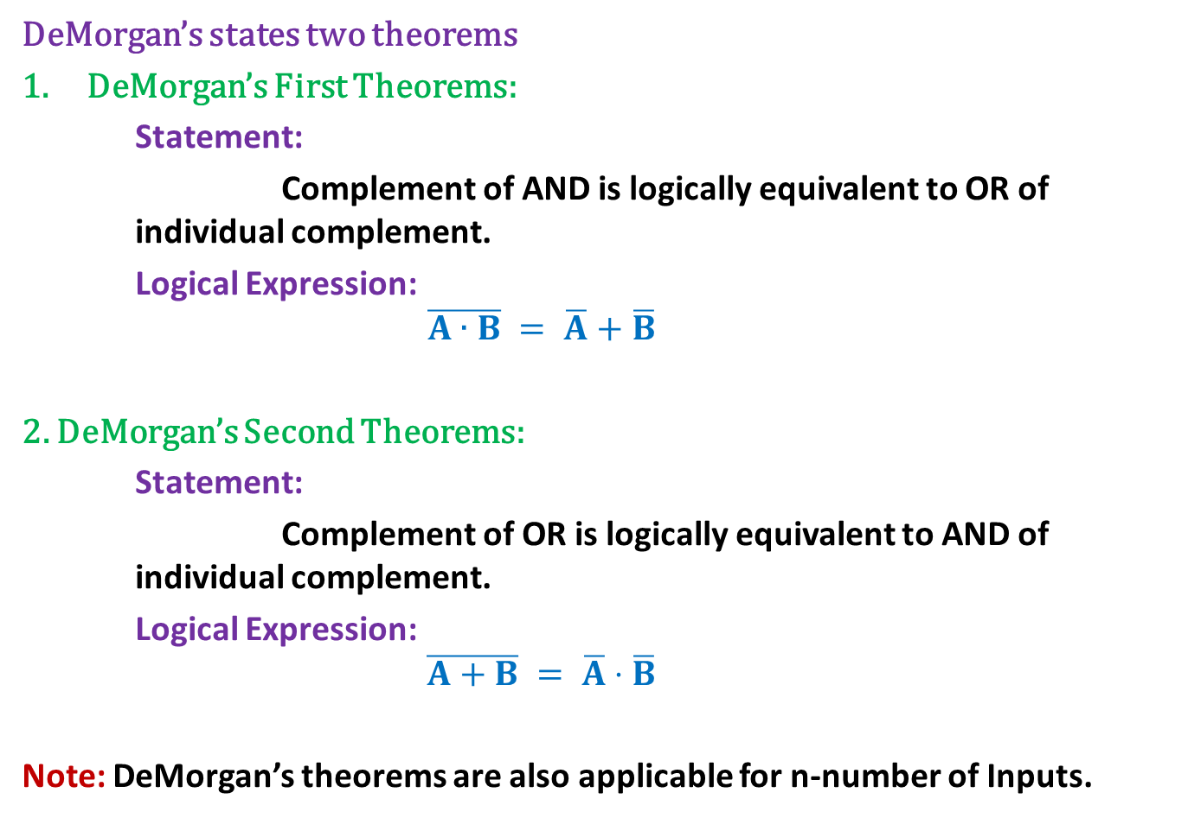
DeMorgan’s Theorem
DeMorgan’s states two theorems
DeMorgan’s First Theorems:
Statement:
Complement of AND is logically equivalent to OR of individual complement.
Logical Expression:
$$\overline{A∙B} = \overline{A}+\overline{B}$$
2. DeMorgan’s Second Theorems:
Statement:
Complement of OR is logically equivalent to AND of individual complement.
Logical Expression:
$$\overline{A+B} = \overline{A}⋅\overline{B}$$
Note:DeMorgan’s theorems are also applicable for n-number of Inputs.

Slide 33
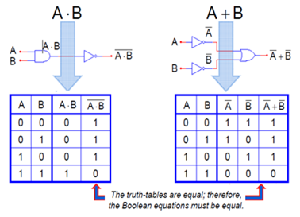

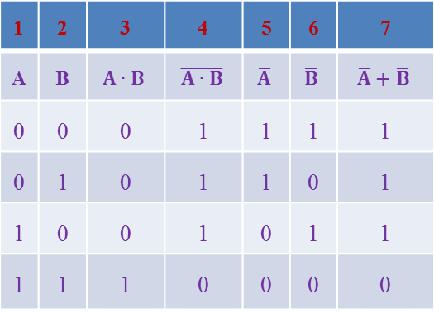
Proof of DeMorgan’s First Theorem
Statement:
Complement of AND is logically equivalent to OR of individual complement.
Logical Expression:
$$\overline{A∙B} = \overline{A}+\overline{B}$$
Proof:
Diagram: | Truth Table: Entries in 4th & 7th columns are identical, hence DeMorgan’s first theorem is proved.
1 | 2 | 3 | 4 | 5 | 6 | 7
A | B | $$A∙B$$ | $$\overline{A∙B}$$ | $$\overline{A}$$ | $$\overline{B}$$ | $$\overline{A}+\overline{B}$$
0 | 0 | 0 | 1 | 1 | 1 | 1
0 | 1 | 0 | 1 | 1 | 0 | 1
1 | 0 | 0 | 1 | 0 | 1 | 1
1 | 1 | 1 | 0 | 0 | 0 | 0

Slide 34
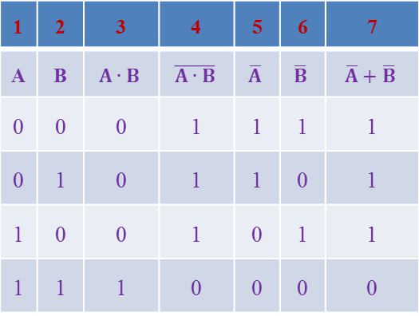
Proof of DeMorgan’s Second Theorem
Statement:
Complement of AND is logically equivalent to OR of individual complement.
Logical Expression:
$$\overline{A∙B} = \overline{A}+\overline{B}$$
Proof:
Diagram: | Truth Table: Entries in 4th & 7th columns are identical, hence DeMorgan’s first theorem is proved.
1 | 2 | 3 | 4 | 5 | 6 | 7
A | B | $$A∙B$$ | $$\overline{A∙B}$$ | $$\overline{A}$$ | $$\overline{B}$$ | $$\overline{A}+\overline{B}$$
0 | 0 | 0 | 1 | 1 | 1 | 1
0 | 1 | 0 | 1 | 1 | 0 | 1
1 | 0 | 0 | 1 | 0 | 1 | 1
1 | 1 | 1 | 0 | 0 | 0 | 0

Slide 35
Adder:
The most basic operation a computer can perform is to add two numbers together through binary
These types of addition operations are carried out by a special kind of combinational circuit called adders.
A combination circuit that performs the addition of two bits is half adder.
A adder performs the addition of 2 significant bits and a previous carry is called a full adder.

Slide 36
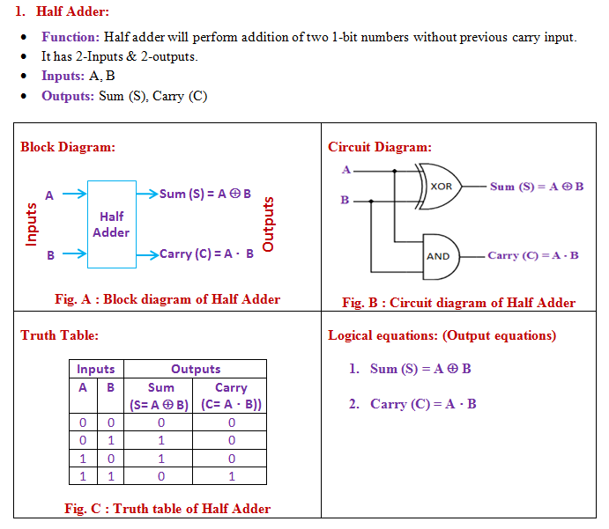
Adder: Half Adder

Slide 37
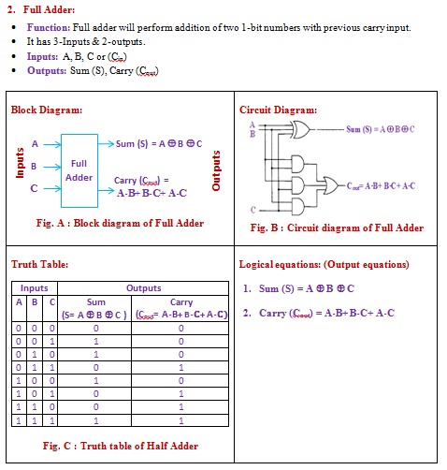
Adder: Full Adder

Slide 38
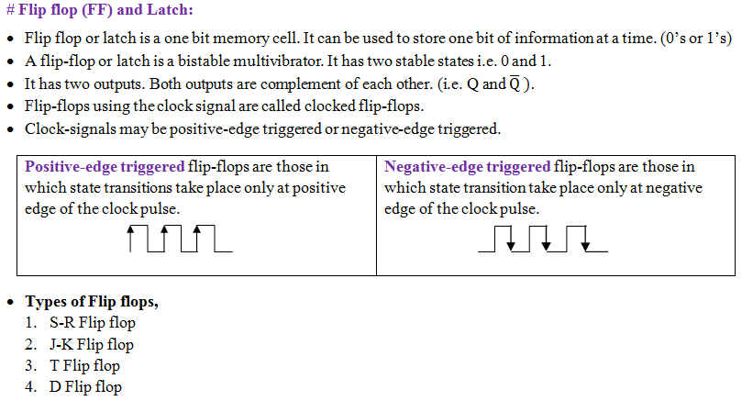
Flip-flops & Latch: 1-bit Memory Cell

Slide 39
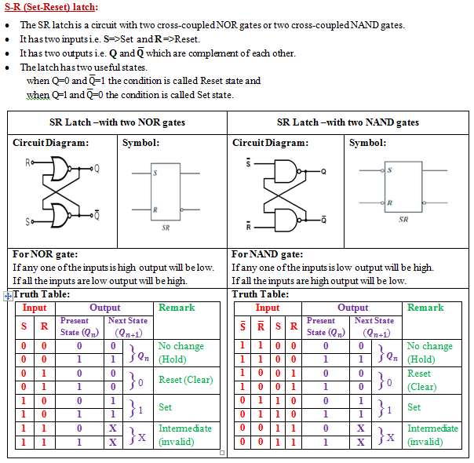

Slide 40
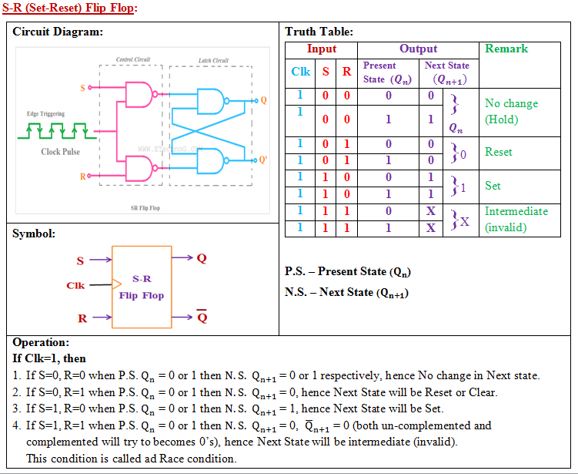
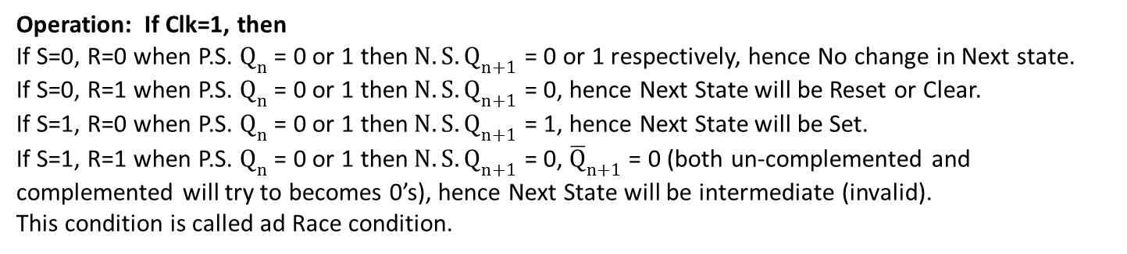
Operation: If Clk=1, then
If S=0, R=0 when P.S. $Q_{n}$ = 0 or 1 then$N.S. Q_{n+1}$ = 0 or 1 respectively, hence No change in Next state.
If S=0, R=1 when P.S. $Q_{n}$ = 0 or 1 then$N.S. Q_{n+1}$ = 0, hence Next State will be Reset or Clear.
If S=1, R=0 when P.S. $Q_{n}$ = 0 or 1 then$N.S. Q_{n+1}$ = 1, hence Next State will be Set.
If S=1, R=1 when P.S. $Q_{n}$ = 0 or 1 then$N.S. Q_{n+1}$ = 0, ${\overline{Q}}_{n+1}$ = 0 (both un-complemented and complemented will try to becomes 0’s), hence Next State will be intermediate (invalid).
This condition is called ad Race condition.

Slide 41
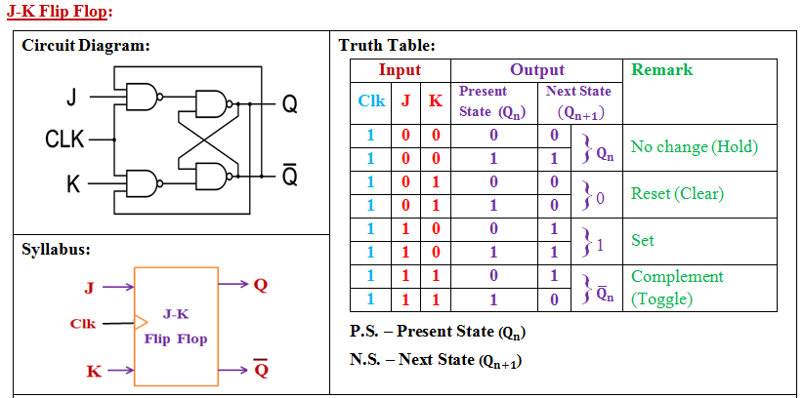
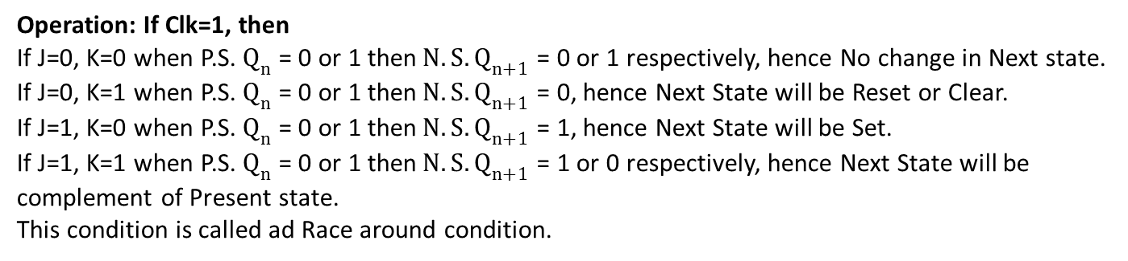
Operation: If Clk=1, then
If J=0, K=0 when P.S. $Q_{n}$ = 0 or 1 then$N.S. Q_{n+1}$ = 0 or 1 respectively, hence No change in Next state.
If J=0, K=1 when P.S. $Q_{n}$ = 0 or 1 then$N.S. Q_{n+1}$ = 0, hence Next State will be Reset or Clear.
If J=1, K=0 when P.S. $Q_{n}$ = 0 or 1 then$N.S. Q_{n+1}$ = 1, hence Next State will be Set.
If J=1, K=1 when P.S. $Q_{n}$ = 0 or 1 then$N.S. Q_{n+1}$ = 1 or 0 respectively, hence Next State will be complement of Present state.
This condition is called ad Race around condition.

Slide 42
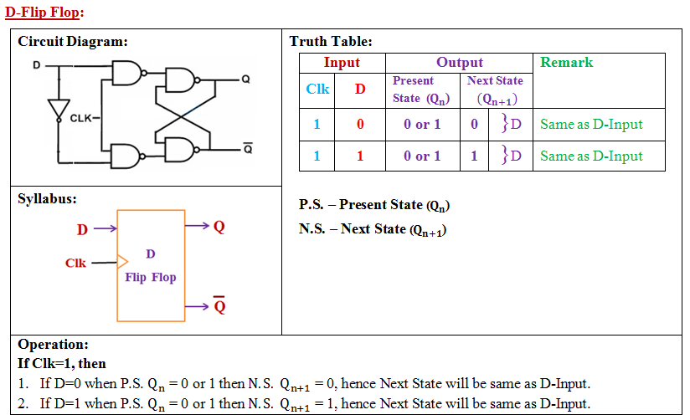

Slide 43
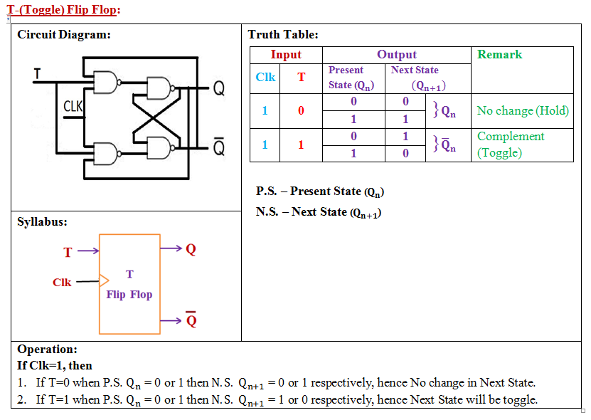

Slide 44
Applications of Flip-Flops
Flip flops can be used,
as a one bit memory cell.
in counters.
in shift registers.
in sequence generators.
in sequence detectors.

Slide 45
Block Diagram of Microprocessor
Accumulator
ALU
Working Registers
Timing & control circuit
Stack pointer
Program counter
Interrupt circuit
Fig. Architecture (Block diagram) of Microprocessor

Slide 46
Block Diagram of Microcontroller
Memory
Accumulator
ALU
Working Registers
Timing & control circuit
Serial I/O ports
Interrupt circuit
ports
Timer/ Counter
Fig. Architecture (Block diagram) of Microcontroller
Microcontroller consists of circuitry of Microprocessor and has in built RAM, ROM, I/O devices, Timers, Counters and other peripheral

Slide 47
Difference Between Microprocessor & Microcontroller
Parameters | Microprocessor | Microcontroller
Contains | ALU, General purpose register, stack pointer, program counter, timing & control circuit, interrupt circuit. | Circuitry of Microprocessor and has in built RAM, ROM, I/O devices, Timers, Counters and other peripheral
RAM, ROM, I/O devices, Timers, Counters and other peripheral | Not present on the chips. | Embedded on the single chip. (inbuilt)
External bus to interface Memory, I/O devices, Timers and other peripherals. | Required | Not required
Memory address space & data | Large & more respectively | Small & less respectively
Multifunction pins | Less | More
Clock speed | High (1 GHz to 4 GHz) | Less (1 MHz to 300 MHz)
Design | Very flexible | Less flexible
Reliability | Less | High
Power consumption | High | Low
Cost | Expensive | Cheap
Available in size | 32-bits, 64 bits | 8-bits, 16 bits
Used for | General purpose applications | Specific applications
Example | 8085, 8086 | 8051, PIC, ARM

Slide 48
Text and Reference Books
“Modern Digital Electronics” by R.P. Jain, 4th Edition, Tata McGraw Hill
“Digital Fundamentals” by Thomas. L. Floyd, 11th Edition, Pearson

Slide 49
THANK YOU

